Slide 1
Progress Report
By: Soumya, Kellen, Abigail, Kevin, Jesus

Slide 2
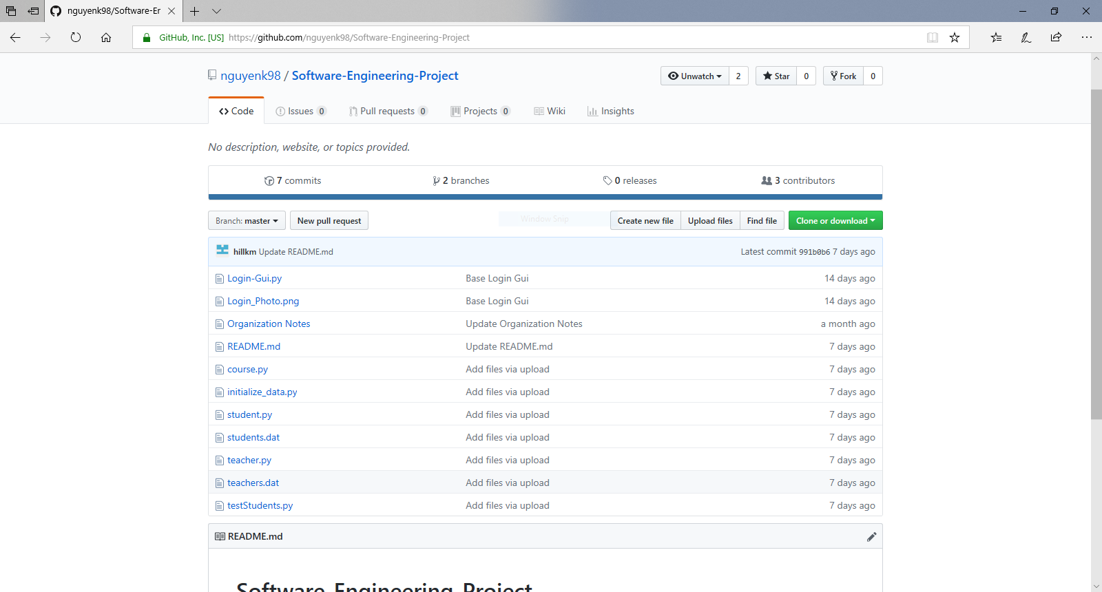
Git Hub

Slide 3
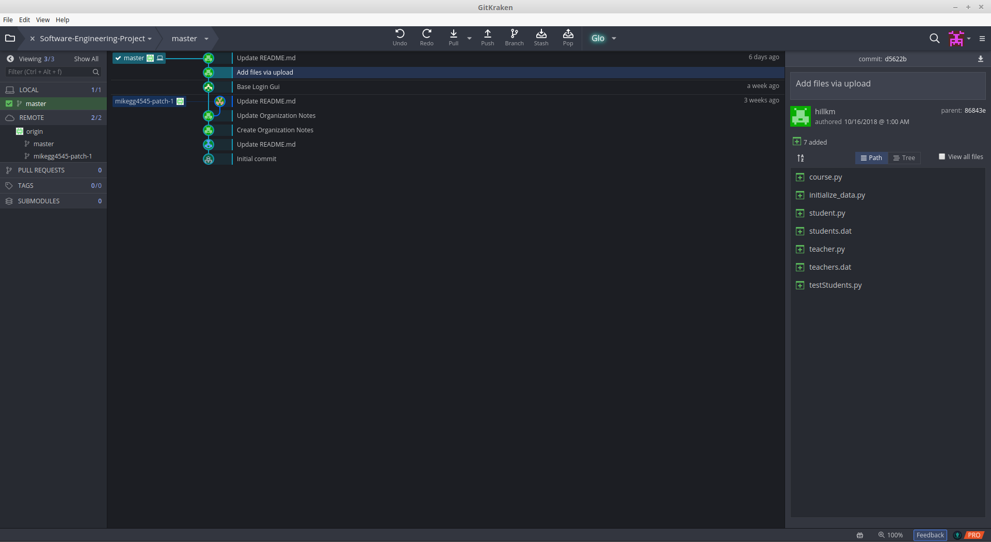
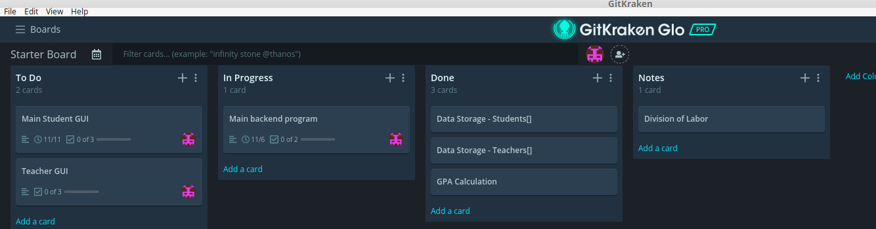
GitKraken
Git manager/visualizer – Allows a user to view github commits, branches, and file diffs
Includes built-in task board software (Glo) that allows for assigning and tracking tasks

Slide 4
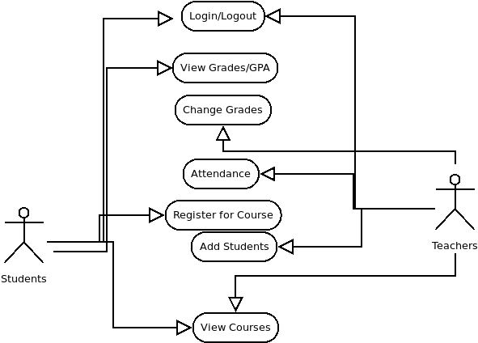
Use Case Diagram

Slide 5
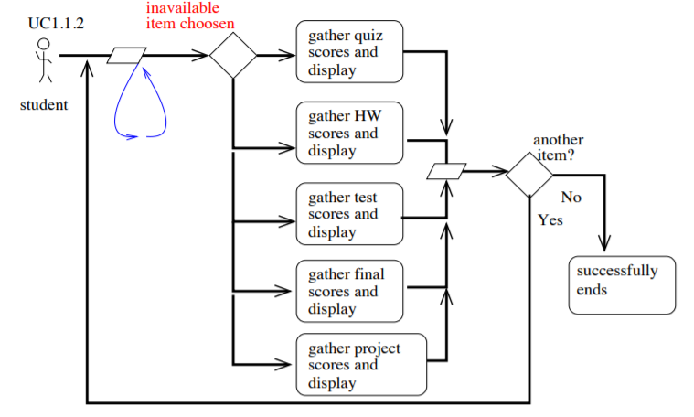
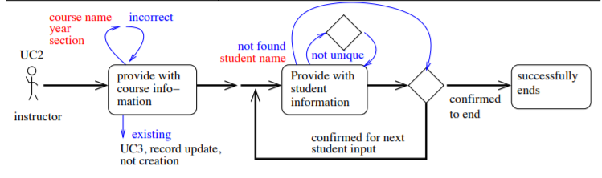
Flow Charts

Slide 6
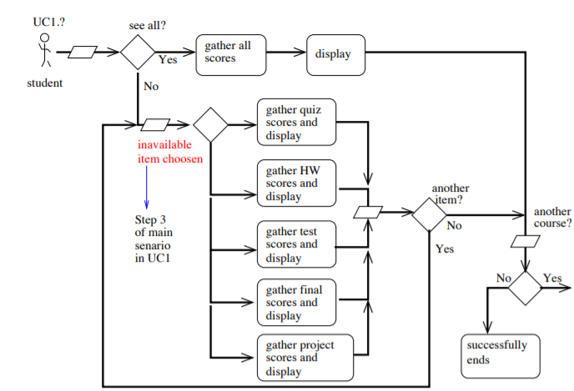
Flow Chart - Student

Slide 7
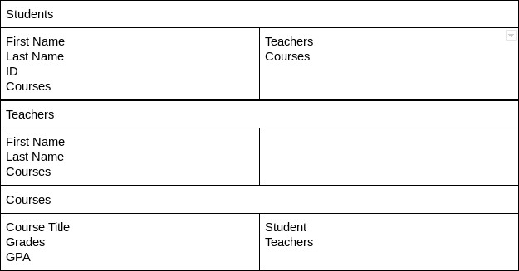
CRC Cards

Slide 8
Tools used for Project
Pycharm
Python
Youtube
Github
GitKraken
Glo

Slide 9
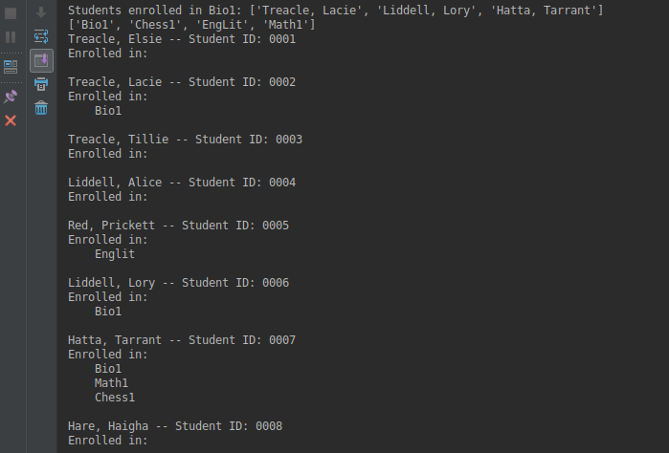
Code we have so far
Login GUI
Storage form the courses, students and teachers.
Grades with GPA calculation
Example data for students, teachers, and grades

Slide 10
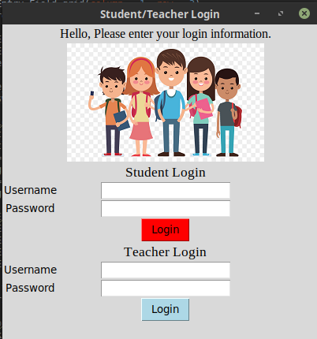
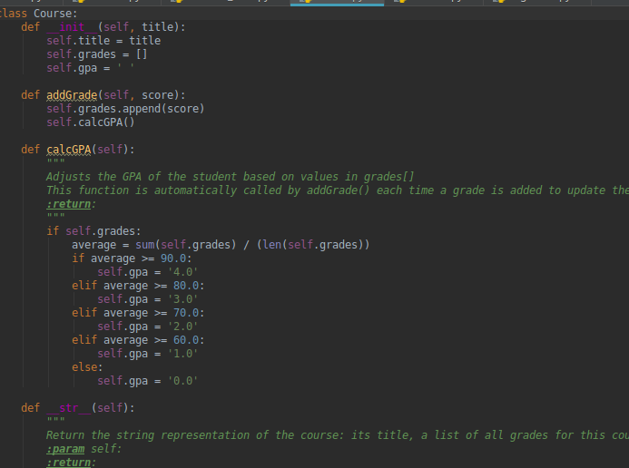
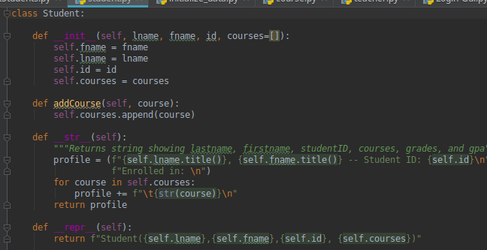
Course, Student, & Log-In Window

Slide 11
To do List…
Complete all the codes
Make sure it works
Test it all out
Put it together

